Slide 1
17 February 2021 | Bulgaria
Deadlines and remedies in public procurement awarding in Bulgaria
SWIPE TO CONTINUE

Slide 2
CMS specialists will be discussing:
deadlines in PP awarding in light of the newly introduced e-procurement and
claims and remedies in PP awarding
SWIPE TO CONTINUE

Slide 3
If your business relies on public procurement procedures or you’d just like updates about the most important issues concerning PP awarding deadlines, join our webinar. No matter whether you’re a contracting authority or a contractor, you’ll find practical tips on how to deal with procurement deadlines in various tender procedures, claims, and remedies. We’ll draw on our depth of experience to share best practices with you!
Antonia Kehayova
Senior Associate
SWIPE TO CONTINUE

Slide 4
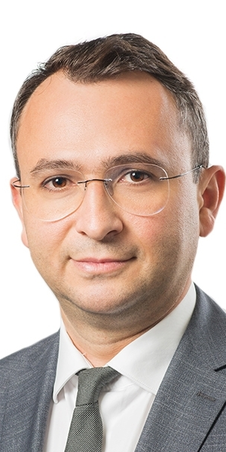
Public procurement procedures are designed to ensure transparency, fairness, and that no tenderers suffer discriminatory treatment. Despite the complexity of these procedures, one has to acknowledge the wonderful opportunities they offer. So make sure you know your rights and are able to make the best out of them!
Dimitar Zwiatkow
Partner
SWIPE TO CONTINUE

Slide 5
More information via the link above

