Slide 1

EU funds for the business in Bulgaria
14 October 2016
Fund Manager of Financial Instruments in Bulgaria EAD

Slide 2
Contents
Fund Manager of Financial Instruments in Bulgaria
Our Partners
Why the Fund of Funds (FoF)
Financial Instruments – framework and achievements
Fund of Funds – An overview
Financial Instruments overview – OPIC
Potential co-financing sources – OPIC
Financial Instruments overview – OPRG
Financial Instruments overview – OPHRD
Financial Instruments overview – OPE
FMFIB for the business
Indicators of success
Implementation schedule
LA CCI FRANCE BULGARIE : FMFIB Presentation, October 2016

Slide 3
Fund Manager of Financial Instruments in Bulgaria
Why the Fund of Funds
Benefits identified at European Union level of mobilizing public and private resources to achieve the strategic objectives of the Union
Increased focus on the use of financial instruments through ESIF in various areas and policies for the period 2014 - 2020 in the EU
Ability to upgrade the accumulated experience in Bulgaria during the previous programming period 2007 - 2013
Strategic need to build national expertise on an international level in the management of these innovative financial solutions*
Identified potential to increase significantly the efficiency and scope of available European funds, thus changing the quality of the economic environment
* The operational structure, key processes and documentation of the Fund of Funds operations have been developed with the with collaboration of EIB, EBRD and the World Bank.
LA CCI FRANCE BULGARIE : FMFIB Presentation, October 2016

Slide 4
Fund Manager of Financial Instruments in Bulgaria
Financial Instruments, framework and achievements
Financial Instruments (FIs) transform EU funds into financial products such as debt, equity and others
FIs support economically viable projects that deliver the objectives of the operational programme
Reach investee targets efficiently through the mechanisms of partnership between the public and private sectors
Managing authority
Grants
Disposable by definition
Achievements due to the use of FIs:
Mobilizing private resources through leverage
Flexibility in achieving the objectives of different types of measures, such as grants, financing, technical assistance
Stimulation of the final recipients seeking to increase their efficiency
Overcoming the risk of dependence on grants
Fund of funds
Financial Intermediaries
Financial instruments
revolving
Final recipients
Source : FMFIB 2016
LA CCI FRANCE BULGARIE : FMFIB Presentation, October 2016

Slide 5
Fund Manager of Financial Instruments in Bulgaria
Fund of Funds, an overview
Financial Instruments implemented through the FoF, management structure
Founded with MC Ordinance 3 as of 22 July 2015 for the establishment of a state-owned entity: Fund Manager for Financial Instruments in Bulgaria EAD with scope - FI management
Operates in accordance with the Common Provisions Regulation 1303/ 2013, Law on ESI Funds Management and Public Procurement Act, for ensuring efficient and effective FI management
Two-tier management structure: Supervisory Board & Management Board
By implementing FI through a FoF the OP’s specific objectives would be achieved, while at the same time providing support to final recipients through partnerships and mobilising private sector funds
Total budget of EUR 606.3 mln within a Fund of Funds managed by FMFIB;
Implementation of specific FIs will be entrusted to Financial Intermediaries selected and overseen by FMFIB.
ESIF
ERDF
CF
EAFRD
ESF
ESF/ YEI
EFMAF
Budget
European funding
National co-financing
OPIC
EUR 235.0 mln
OPRG
EUR 189.1 mln
OPHRD
EUR 35.8 mln
OPE
EUR 146.4 mln
Private investors
Fund of funds
FMFIB
OP contribution
Private funding
Financial instrument
Financial intermediaries
Funds
Final recipients
Source : FMFIB 2016
LA CCI FRANCE BULGARIE : FMFIB Presentation, October 2016

Slide 6
Fund Manager of Financial Instruments in Bulgaria
Financial Instruments overview - OPIC
Financial instruments framework
Contr. in EUR mln and OPIC share
FI
Final recipients
OPIC contribution amounts to EUR 235 mln allocated to seven financial instruments
Minimum contribution from private investors is estimated at EUR 410 mln and hence, the cumulative support to be channeled to final recipients totals EUR 575 mln
Projected leverage of the FIs – 2.45x
Envisaged marginal contribution from the financial intermediaries specifically which will be explored during the market test in further details
Technology transfer fund
SME & Large corporates
30 М
90%
Acceleration & Seed Fund
SME
(in OPIC’s context)
55 М
90%
Venture capital fund
SME
(in OPIC’s context)
25 М
60%
OPIC Contribution
(EUR 235 М)
Mezzanine fund
SME
(in OPIC’s context)
40 М
60%
Capped portfolio guarantees *
SME & Large corporates
70 М
80%
Microfinance risk sharing facility
SMEs, primarily Micros
15 М
70%
Private contribution
(approx. EUR 410 М)
Source : FMFIB 2016
LA CCI FRANCE BULGARIE : FMFIB Presentation, October 2016

Slide 7
Fund Manager of Financial Instruments in Bulgaria
Potential co-financing sources - OPIC
MA OPIC
IS envisages for FMFIB to procure minimal financial leverage to OPIC’s contribution re. each instrument
Three options are contemplated for the attracting of co-financing from public and private partners, i.e. on FoF, on Financial Intermediaries and on Final recipients levels
Potential partners at FoF level encompass IFIs present on the local market
IS defines potential co-financing partners at financial instrument level as own contribution, IFIs, local financial institutions (including development banks) as well as other private local and international investors
Considerable leverage anticipated on final recipients level in light of the expected additional co-financing, including recipients own funds
OP contr.
International Finance Institutions
Co-financing
Fund of Funds
IFI
Financial Intermediaries
Regional development institutions
Private companies
High Net Worth Individuals
OP contr.
Co-financing
Financial instruments
Support
Private and institutional investors
Banks
Own funds
Final recipients
Co-financing
Source : FMFIB 2016
LA CCI FRANCE BULGARIE : FMFIB Presentation, October 2016

Slide 8
Fund Manager of Financial Instruments in Bulgaria
Financial Instruments overview - OPRG
Fund of Funds
Tourism Development Tool
UDF Sofia Region
UDF South Region
UDF North Region
Guarantee Instrument
Managing Authority
Attracted additional funding
Low-interest Loans
Loan Guarantees
Private Investors, Individuals, Public Private Partnerships, Municipalities
Urban Development
(urban transportation, economical zones, sport and cultural infrastructure)
Energy Efficiency (ЕЕ) for student dormitories and single-family residential buildings
Tourism Development and Cultural Heritage
(T and CH)
Grants to municipalities for EE, T and CH
Source : FMFIB 2016
LA CCI FRANCE BULGARIE : FMFIB Presentation, October 2016

Slide 9
Fund Manager of Financial Instruments in Bulgaria
Financial Instruments overview - OPHRD
Management structure of the FoF in the context of OPHRD
Managing Authority, OPHRD
Financial Instruments financed through OPHRD are :
    Microfinancing with risk sharing EUR 27 mln; and
    Capped Portfolio Guarantees EUR 8.8 mln.
OPHRD supports the achievement of national goals in the field of employment, preventing poverty and social exclusion in the context of the strategy “Europe 2020”
Over 76% of the population between 20 and 64 years of age to be in employment by 2020
Reduction the number of people in poverty by 260,000 people by 2020
Microfinancing with risk sharing
27.0 М Euros
Capped Portfolio Guarantees
8.8 М Euros
Financial Agreement
Fund of Funds
Asset Management
FMFIB
Financing
FoF
Choice
Financial Intermediary 1
Financial Intermediary 2
Negotiation
Relationship Management
Financial Intermediary 3
Financial Intermediary N
New Microcredit Portfolio
Final Recipients
Source : FMFIB 2016
LA CCI FRANCE BULGARIE : FMFIB Presentation, October 2016

Slide 10
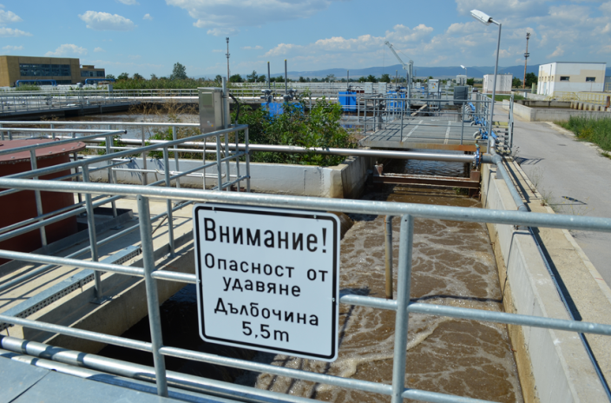
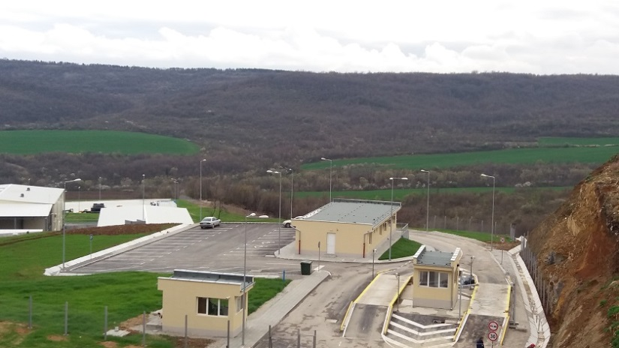
Fund Manager of Financial Instruments in Bulgaria
Financial Instruments overview - OPE
Management structure of the FoF in the context of OPE 2014 - 2020
Financial Instruments in relation to OPE are in two areas : Water and Waste
They contribute to the achievement of some of the thematic objectives under Regulation 1303/2013
Promoting adoption of climate change prevention and risk management
Preserving and protecting the environment and promoting resource efficiency
OPE 2014 - 2020
I Water
~1.2 billion euros
II Waste
~0,3 billion euros
Financial Instruments Budget
I Water
119.6 million Euros
II Waste
26.8 million Euros
Investment Strategy
Source : FMFIB 2016
Wastewater treatment plant
Landfill
LA CCI FRANCE BULGARIE : FMFIB Presentation, October 2016

Slide 11
Fund Manager of Financial Instruments in Bulgaria
FMFIB for the business
Improving the business and living environment
Green areas and parks
Urban infrastructure
Projects for the urban population as well as their visitors, guests and tourists
Urban mobility and public transport
Rehabilitation and construction of new bike lanes
Waste-water treatment plants and landfills
Innovative projects (i.e. tech parks, research labs, start-ups, patents and others)
SME Financing
Microfinancing
European Funding
CITIES
FMFIB
INNOVATION
RURAL DEVELOPMENT
PROJECTS
Public and private investors
WASTE AND WATER
BUSINESS
Source : FMFIB 2016
OTHER PROJECTS
LIVING ENVIRONMENT
Source : FMFIB 2016
LA CCI FRANCE BULGARIE : FMFIB Presentation, October 2016

Slide 12
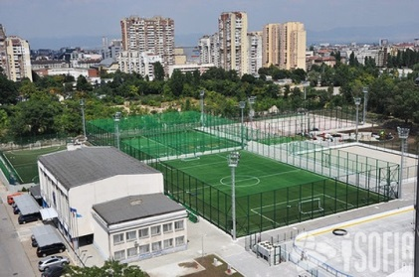
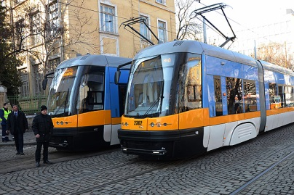
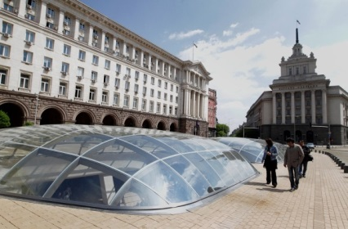
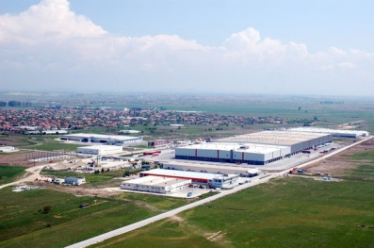
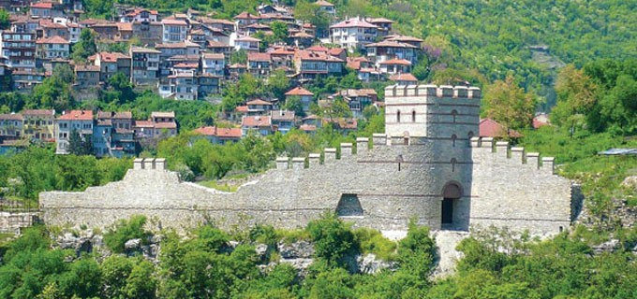
Fund Manager of Financial Instruments in Bulgaria
Indicators of success
The application of financial instruments will contribute to achieving the objectives of the Operational Programmes
FMFIB interests are consistent with the agreed EU indicators through an integrated system for monitoring the effects of financial instruments
The main indicators that will be monitored in the implementation process are:
  Reducing CO2 emmission
  Total length of new or improved public transport
  Number of households passed in a higher class of energy
  Created or rehabilitated undeveloped space in urban areas
  Renovated public and commercial buildings in urban areas
  Increasing tourist arrivals
  Development of cultural heritage
  Employment
LA CCI FRANCE BULGARIE : FMFIB Presentation, October 2016

Slide 13

Fund Manager of Financial Instruments in Bulgaria
Implementation schedule
Приключване структурирането на екипа
The operation of FMFIB as manager of the Fund of Funds is a factor of several important steps
Furthermore, the key activities that the FMFIB is starting with include:
  Structuring of specific financial instruments and testing them on the financial markets
  Selection of financial intermediaries
Сертифициране от страна на ОСЕС
Finalizing negotiations with MA
Continuing the partnership with MINFIN
Structuring of financial instruments
Selection of financial intermediaries
LA CCI FRANCE BULGARIE : FMFIB Presentation, October 2016

Slide 14
Fund Manager of Financial Instruments in Bulgaria
Thank you !
Contact: 30-32, “Gen. E.I.Totleben” blvd
Sofia, Bulgaria
Phone: +359 2 801 40 50
E-mail: office@fmfib.bg
Web: www.fmfib.bg
LA CCI FRANCE BULGARIE : FMFIB Presentation, October 2016

